Slide 1
BARC Tube Bending Week 10

Slide 2
Checklist
Process: Manual Edge detection Smoothing edges Fitting lines to straight sections Angle Calculation Part 1 ( Bends 1 & 2) Part 2 ( Bends 2,3 & 4) Automated Edge detection Smoothing edges Fitting lines to straight sections Angle Calculation Part 1 ( Bends 1 & 2) Part 2 ( Bends 2,3 & 4) | Varying Parameters: Background Color Background Brightness Distance to LED box Height of camera Camera Orientation Lighting (Front vs Back) Different cameras/lenses Adding noise (non-ideal lighting conditions) No. of Cameras

Slide 3
2.4 Last week’s results
Higher megapixel camera can have wider field of view and thus, not necessarily as many points on the target area as expected.
Camera(Intrinsic) and surroundings add to the error as seen when taking multiple pictures and getting angle error difference.
Computing the jaggedness of the line fit can give insights on the length to be considered for angle calculation.

Slide 4
Current Week Effort
Setting up the test rig with new rails for capturing images at higher camera distances to compare with 75mm lens.
Calculating angle error for both white and blue background lighting at a distance of 42 inches with 20MP camera and 75mm lens

Slide 5
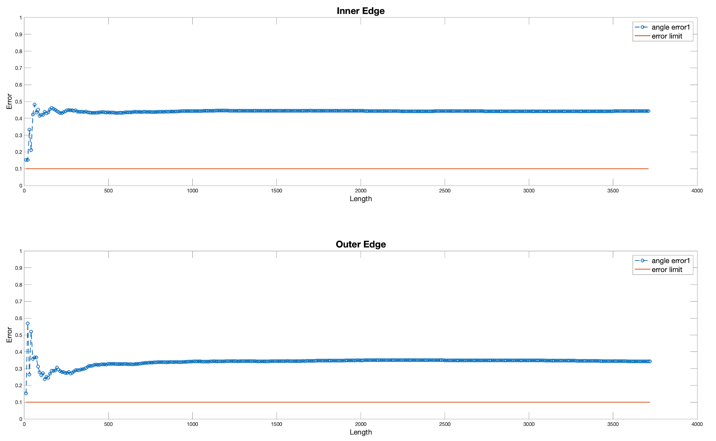
Angle error plot - 20MP - 42 in
1cm = 300 pixels
All Errors are above 0.4

Slide 6
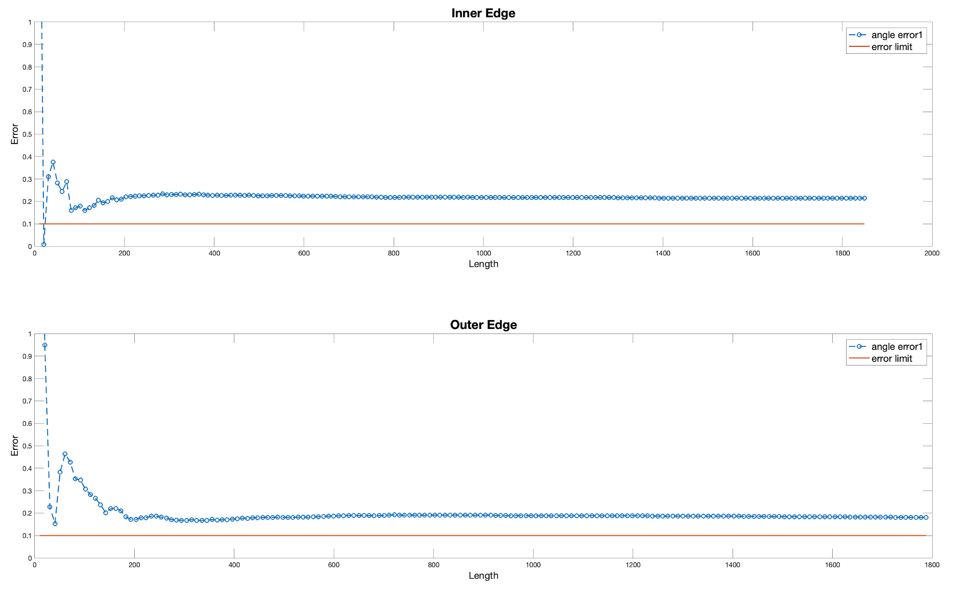
Angle error plot - 5MP - 42 in
2k camera is better now

Slide 7
Current Week Effort (Continued)
Quantifying the “Jaggedness” of each edge for both white and blue backgrounds at 42 in. height with 75mm lens and 20MP camera

Slide 8
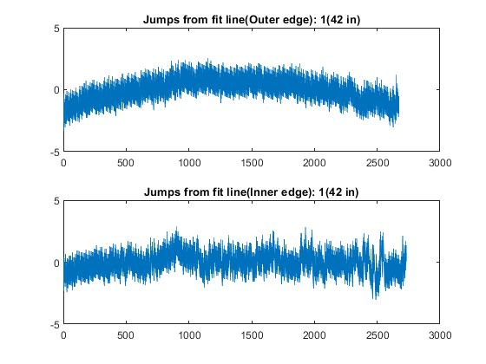
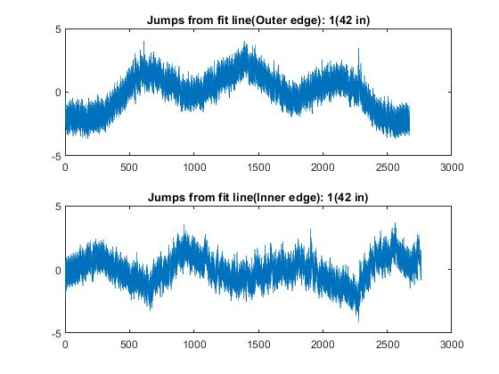
Bend 1
Blue
White

Slide 9
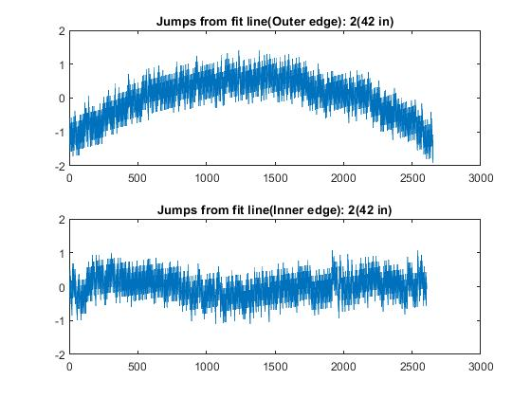
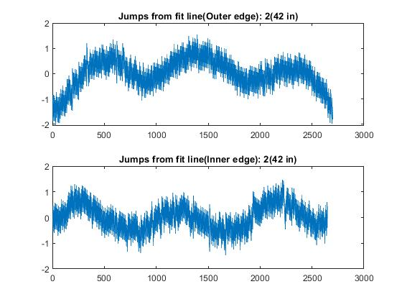
Bend 2
Blue
White

Slide 10
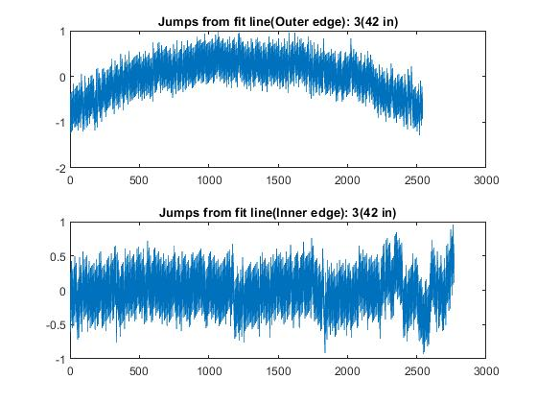
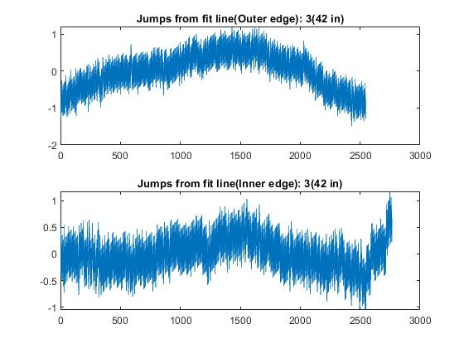
Bend 3
Blue
White

Slide 11
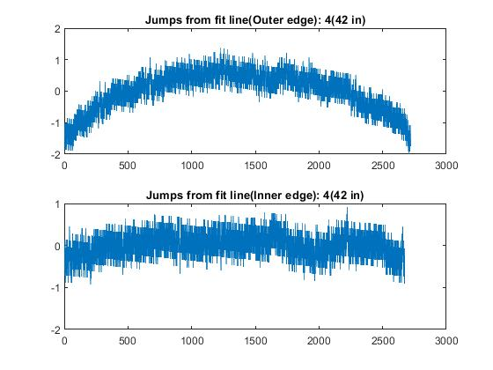
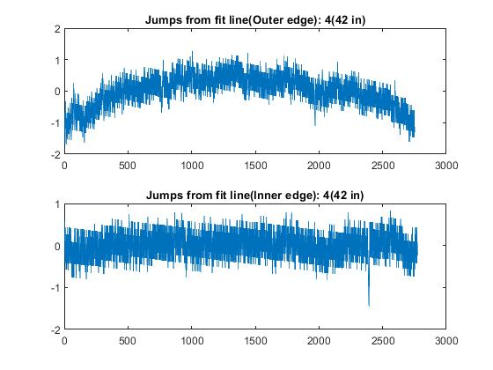
Bend 4
Blue
White

Slide 12
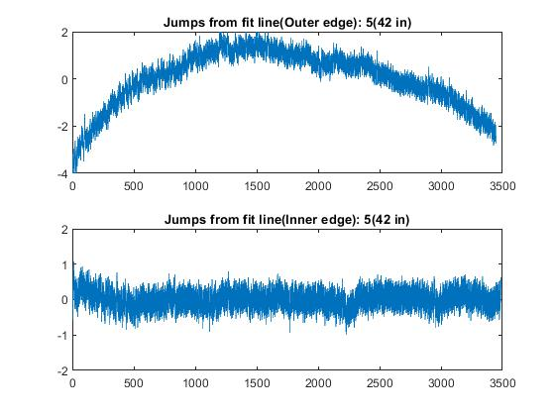
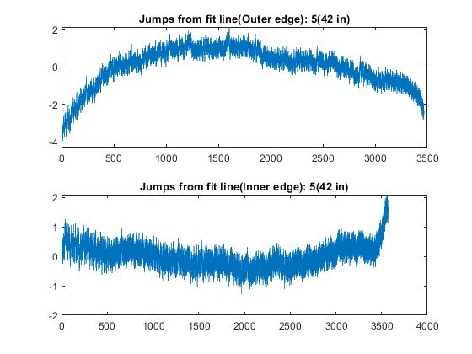
Bend 5
Blue
White

Slide 13
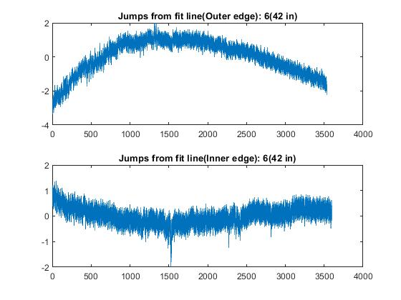
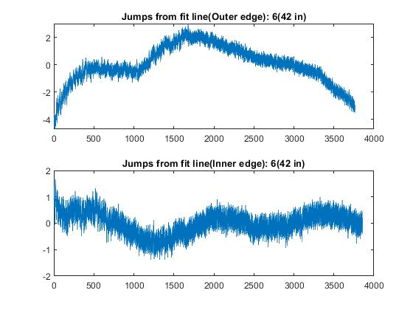
Bend 6
Blue
White

Slide 14
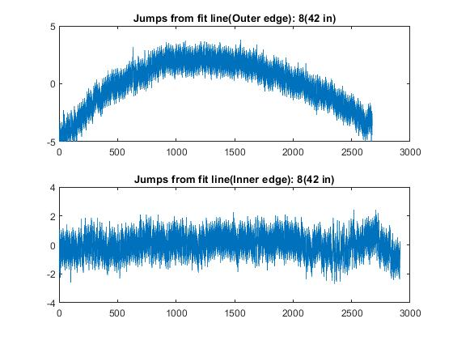
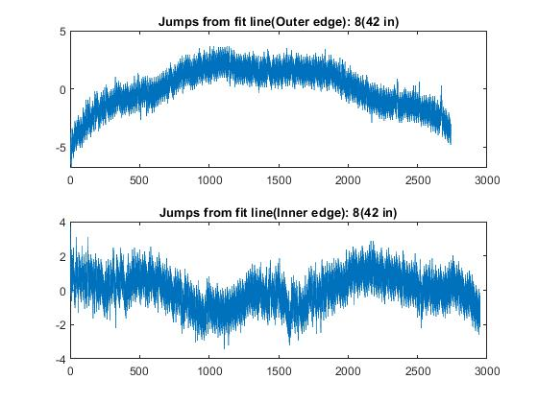
Bend 8
Blue
White

Slide 15
Insights
In most cases, the jaggedness is lesser ( fit better) for blue background rather than white. We will compare with other background colours.
The inner edge is giving less jaggedness as compared to the outer edge.

Slide 16
Current Week Effort (Continued)
Verification of our angle calculation method by checking jaggedness of straight iron rod vs ideal line vs bend sample straight section

Slide 17
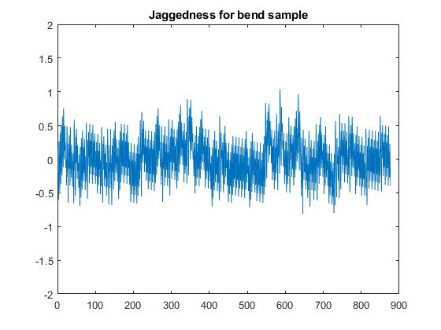
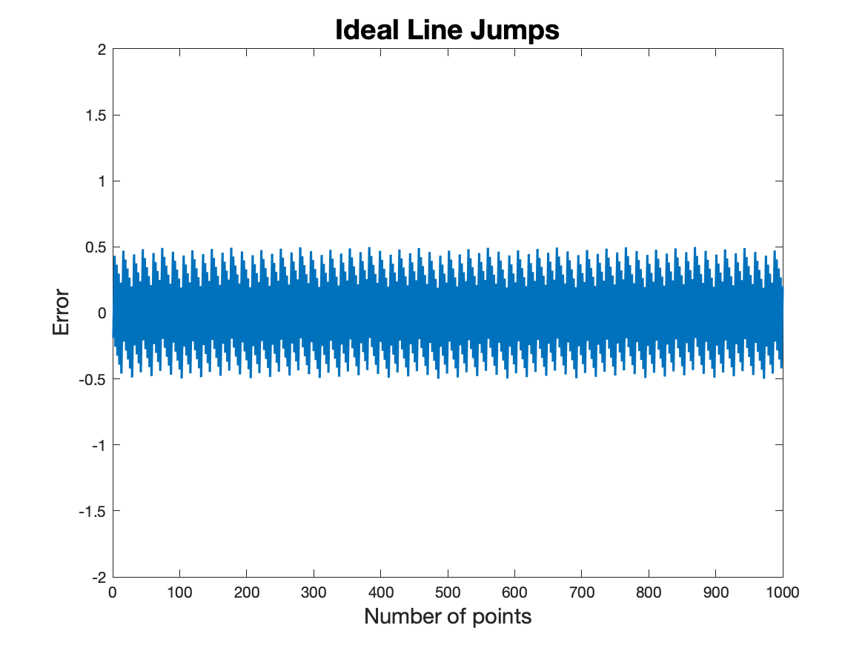
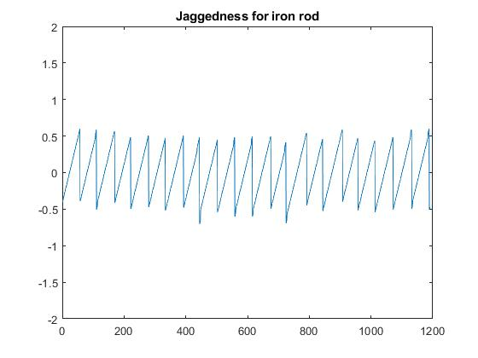
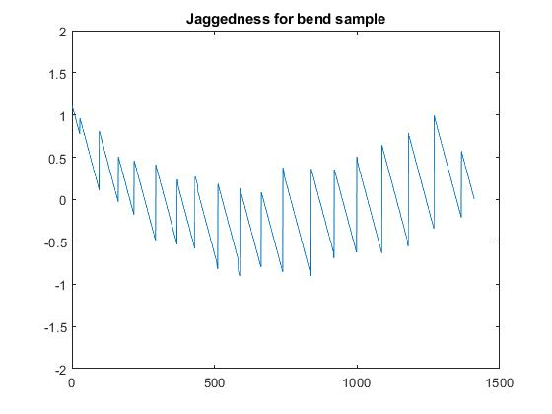
Method check - jaggedness
Bend sample jaggedness
Ideal line jaggedness
Iron rod jaggedness

Slide 18
Insights
Jaggedness in straight section of bend sample is slightly worse than ideal line jaggedness as well as iron rod jaggedness.
Jaggedness in slant(bent) section of bend sample is almost good as ideal line and iron rod jaggedness but this doesn’t translate to similar angle error trend. So good fit doesn’t necessarily translate to accurate angle error calculation.

Slide 19
Future work
Compare results and quantify no. of points.

